Slide 1

Computational Methods for Quantum Many-Body Systems (CMQMB) -
from artificial atoms to high-temperature superconductors
6 CFUs
Dr. Thomas Schäfer Università degli studi di Trieste (UNITS), Winter Semester 2025

Slide 2
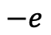
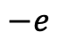
Fascinating physics from electron-electron interactions
Classical electrostatics:
Coulomb force
$$−e$$
$$−e$$

Slide 3
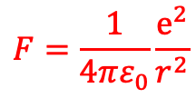
Fascinating physics from electron-electron interactions
→ repulsion
Classical electrostatics:
Coulomb force
$$−e$$
$$−e$$
$$F=\frac{1}{4πε_{0}}\frac{e^{2}}{r^{2}}$$

Slide 4
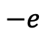
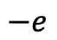
Fascinating physics from electron-electron interactions
→ repulsion
Classical electrostatics:
Coulomb force
$$−e$$
$$−e$$
$$F=\frac{1}{4πε_{0}}\frac{e^{2}}{r^{2}}$$
But Coulomb interaction can also lead to an (effective) attraction!
$$−e$$
$$−e$$

Slide 5

Fascinating physics from electron-electron interactions
→ repulsion
Classical electrostatics:
Coulomb force
$$−e$$
$$−e$$
$$F=\frac{1}{4πε_{0}}\frac{e^{2}}{r^{2}}$$
But Coulomb interaction can also lead to an (effective) attraction!
$$−e$$
$$−e$$
→ Cooper pairs and
superconductors

Slide 6
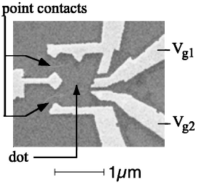
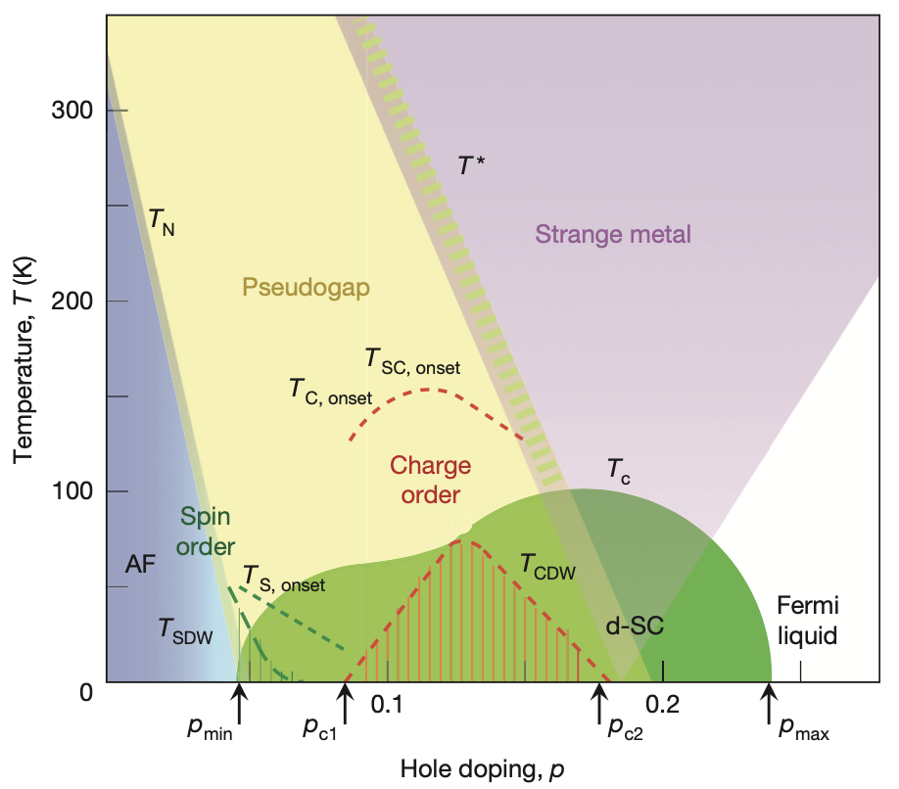
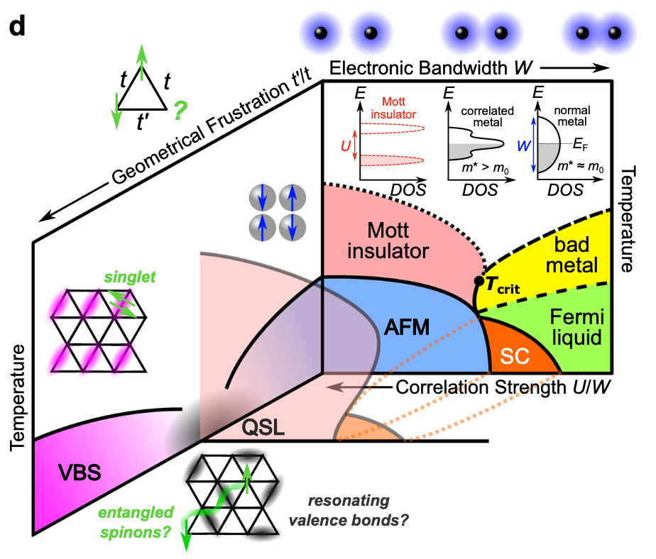
Fascinating physics from electron-electron interactions
“Artificial materials” (quantum dots, cold atoms, moiré, …)
Mott metal-insulator transitions
Quantum magnetism and high-T_{c} superconductivity
J. A. Folk, et al., Phys. Rev. Lett. (1996)
A. Pustogow, et al., Nat. Comm. (2023)
B. Keimer, et al., Nature (2015)

Slide 7


Fascinating physics from electron-electron interactions
“Artificial materials” (quantum dots, cold atoms, moiré, …)
Mott metal-insulator transitions
Quantum magnetism and high-T_{c} superconductivity
J. A. Folk, et al., Phys. Rev. Lett. (1996)
A. Pustogow, et al., Nat. Comm. (2023)
B. Keimer, et al., Nature (2015)
The course Computational Methods for Quantum Many-Body Systems (CMQMB)
introduces the physics of these fascinating phenomena,
provides analytical and numerical tools for the description and understanding of these systems at the forefront of current research,
introduces the students to the open-source Toolbox for Research on Interacting Quantum Systems (TRIQS), used in many research groups around the world working on the quantum many-body problem, and
covers hands-on examples of state-of-the-art algorithms like the dynamical mean-field theory (DMFT) in classroom.
https://triqs.github.io/triqs

Slide 8

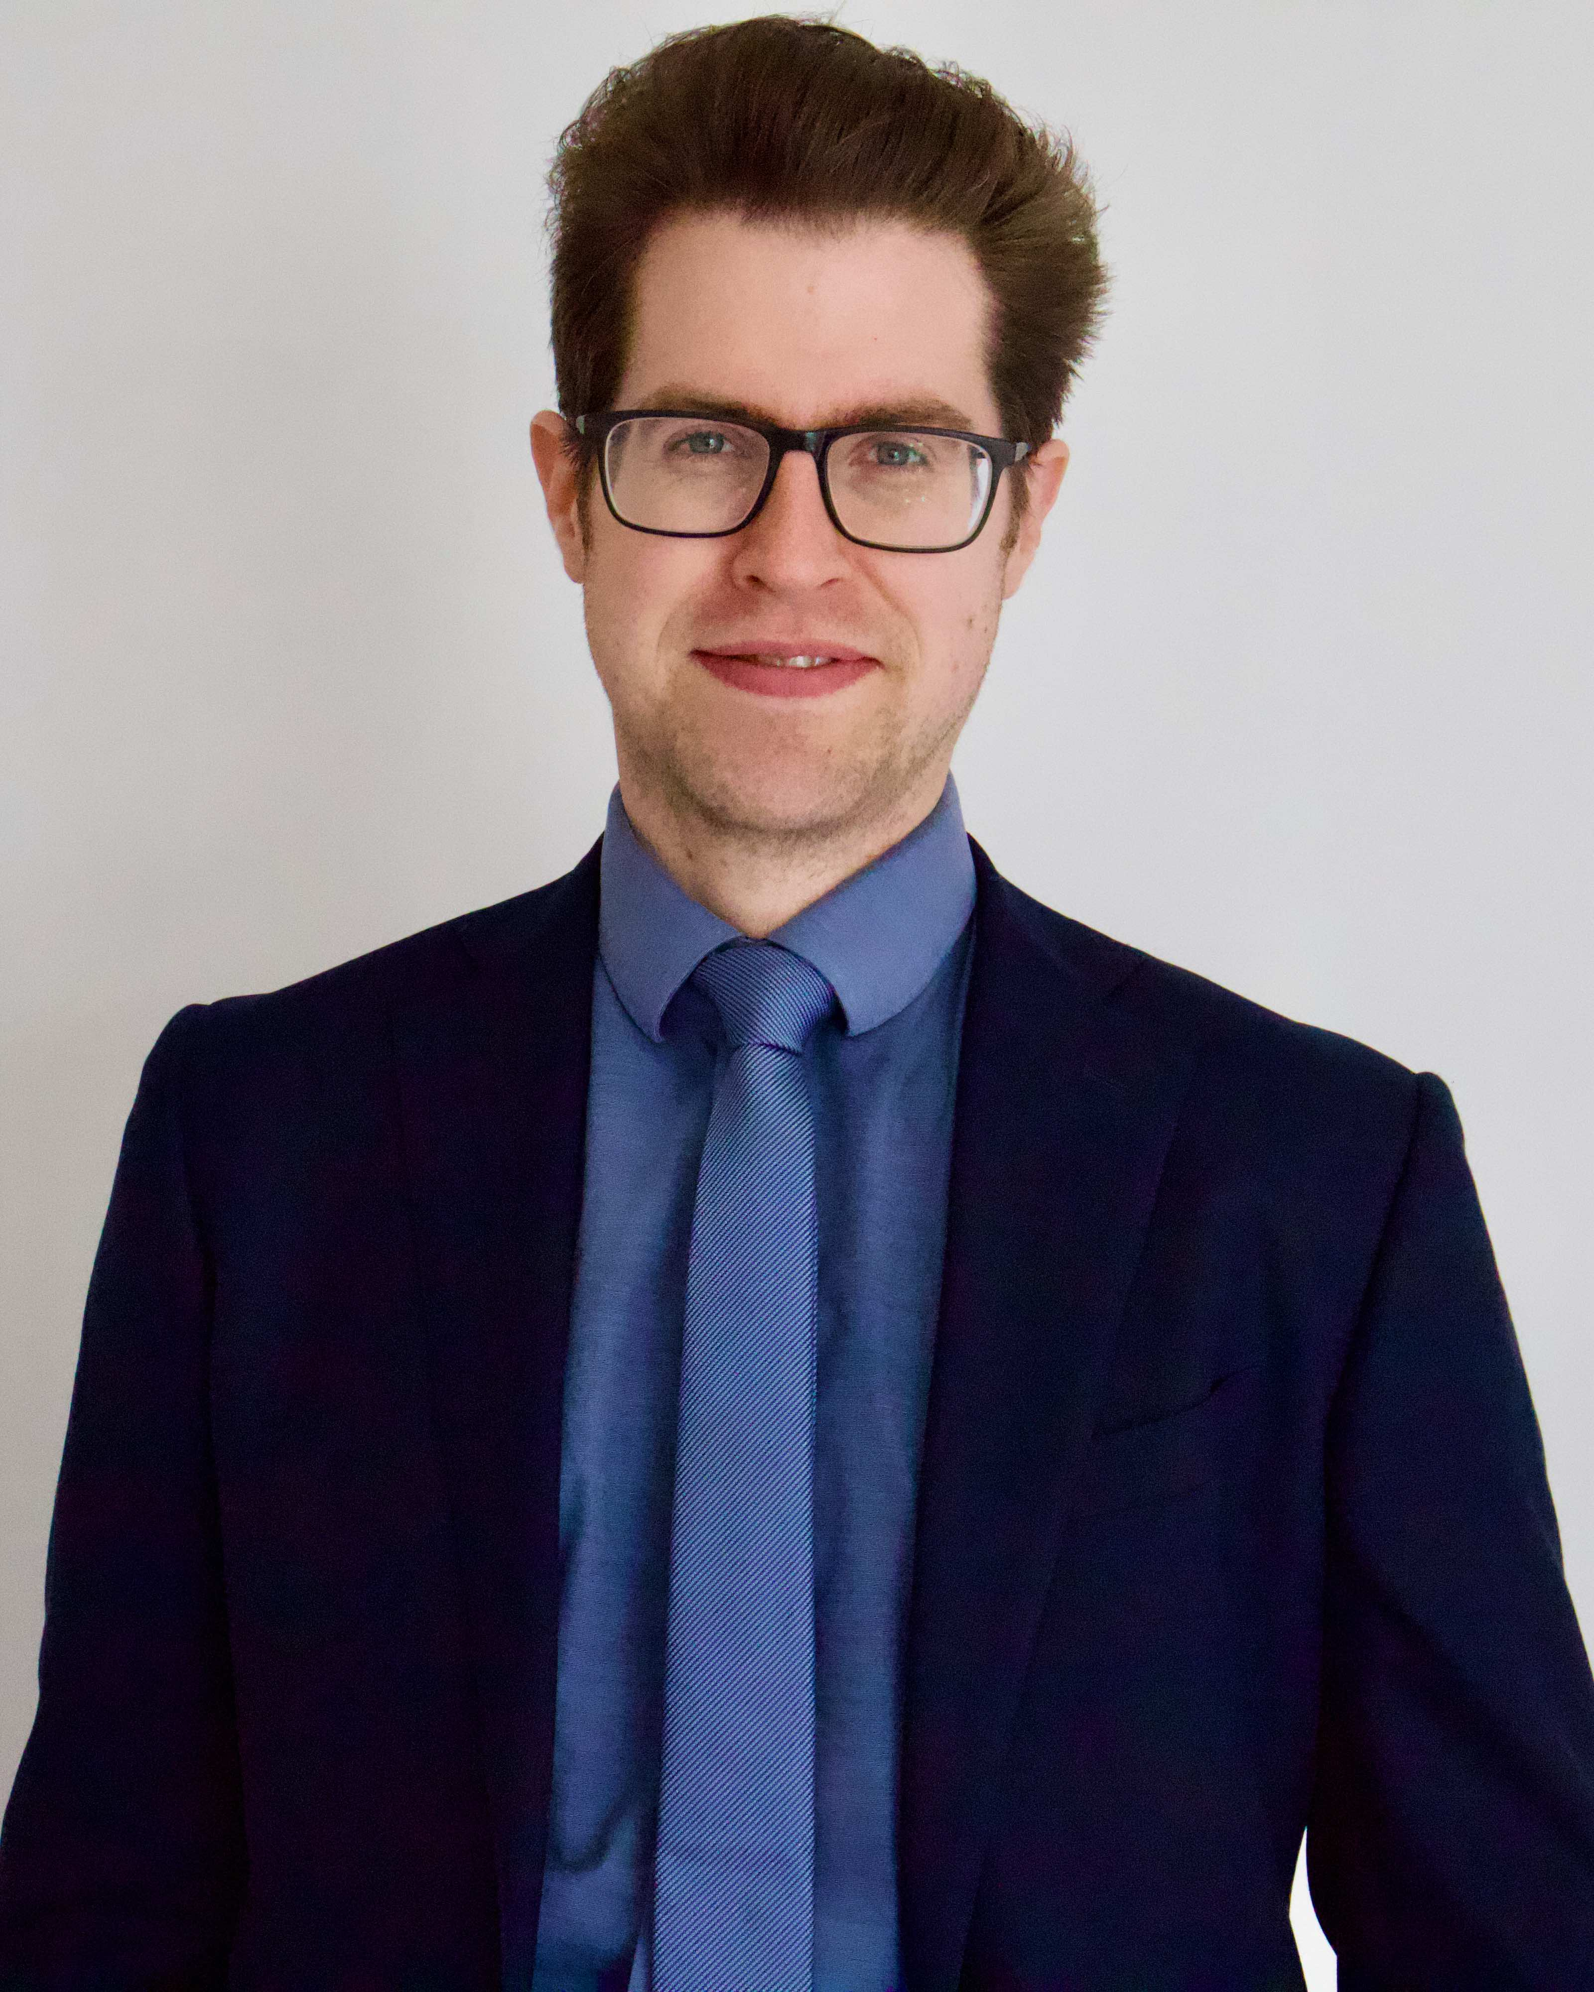

Interested in Computational Methods for Quantum Many-Body Systems?
Thomas Schäfer
Mon 9:15 – 11:00 Aula B (Edificio F) Tue 11:15 – 13:00 Aula A Idraulica (Edificio C2)
Via Valerio, 2 - 34127 Trieste
Strada Costiera, 11 - 34151 Trieste
Office 252
thomas.schaefer@units.it

